Slide 1
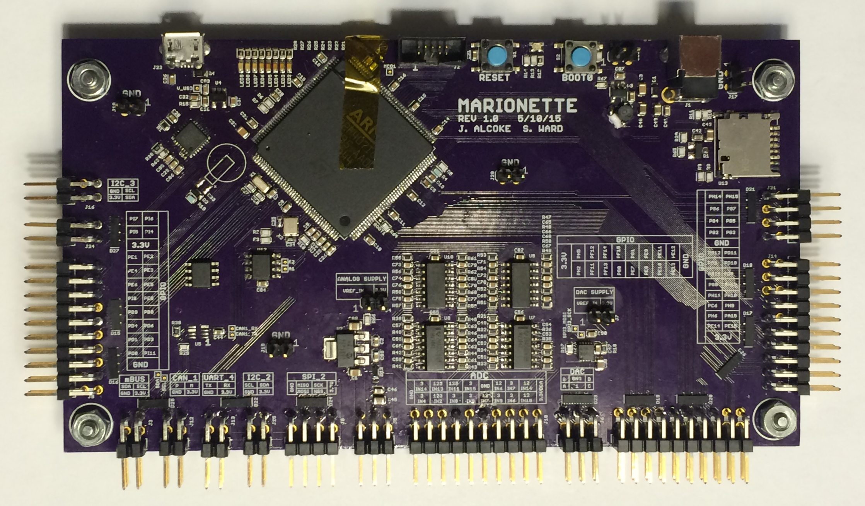

Marionette DAQ
Summary
Solution
DAQ Comparison
The Marionette DAQ is a an open source industrial quality data acquisition device designed for the Portland State Aerospace Society. The underlying goal of the project is to provide a DAQ that is:
Completely Open Source (hardware, firmware, and Interface software).
Provides more connectivity than any other device currently on the market.
All for an affordable (to students) cost.
Off the shelf 32bit microcontroller with USB 2.0 High Speed.
Easy to assemble, components can be placed by hand.
A real time operating system (ChibiOS) with customized drivers and libraries
Uses the Python scripting language for a fully customizable, cross-platform user interface.
Problem Statement
Data acquisition (DAQ) systems are critical to any automation or sampling project that you want to quickly throw together. All of the existing DAQ modules are hard to use, aren’t cross platform, or have very poor performance.
Everyone needs DAQs. From ECE students sampling circuits to MEs controlling motors to CS students trying to interface to the outside world. There is a desire to replace the learning curve of complicated, poorly written documentation and system restricted devices to a simple, flexible, and easy to use DAQ.
Contributing Members
Capstone Team:
Jeff Alcoke, ECE – Project HW Designer
Seth Ward, ECE – Project FW Designer
Special thanks to:
Andrew Greenberg
K. Willson
Gavin Gallino
Dave Camarillo
Department of Electrical and Computer Engineering

